Slide 1
TEAM FOURTRESS
APPLICATION DEMO & PROGRESS UPDATE

Slide 2
PM REVIEW COMMENTS
Add testing to all critical path (Jorden)
Add testing to project schedule (Feng feng)
Add test cases and test documentation to git (Eugene, Jane)
Create task metrics (Jane)
Remove duplicate minutes (Weiling)
Find the missing git commit in drive (Weiling)
Break down tasks to smaller tasks on Critical path and schedule (Jorden & FF)
Change attended to attendees (Eugene)
Bug metrics (Eugene)
Send email link to google drive (Jane)

Slide 3
SCHEDULE DURING PM REVIEW
WEEK 7 - COMPLETE BOOTSTRAP
WEEK 8 - COMPLETE BASIC LOCATION REPORTS
WEEK 9 - COMPLETE HEATMAP & AUTOMATIC GROUP IDENTIFICATION
WEEK 10 - COMPLETE DUAL INTERFACE
WEEK 11- COMPLETE ALL FUNCTIONALITIES
WEEK 12 – UAT
WEEK 13 – FINAL ADJUSTMENTS
WEEK 14 - FINAL PRESENTATION

Slide 4
PROGRAMMING TASKS
BASIC LOCATION REPORT: FENGFENG & JANE
BOOTSTRAP: JORDEN & EUGENE (WEEK 7&8) & WEILING & EUGENE (WEEK 9)
CODE TESTING: WE TEST ON EACH OTHER’S CODE

Slide 5
NON-PROGRAMMING TASKS
CLASS DIAGRAM: JANE
SEQUENCE DIAGRAM: WEILING & FENGFENG
SCHEDULE: PM OF THE WEEK

Slide 6
NEW SCHEDULE
WEEK 7 & 8 - COMPLETE BOOTSTRAP & BLR (BREAKDOWN)
WEEK 9 - UPLOAD ADDITIONAL DATA & BLR (TOP-K POPULAR PLACE) & HEATMAP
WEEK 10 - COMPLETE BLR & AUTOMATIC GROUP IDENTIFICATION
WEEK 11 - COMPLETE DUAL INTERFACE
WEEK 12- COMPLETE ALL FUNCTIONALITIES & UAT
WEEK 13 – FINAL ADJUSTMENTS
WEEK 14 - FINAL PRESENTATION

Slide 7
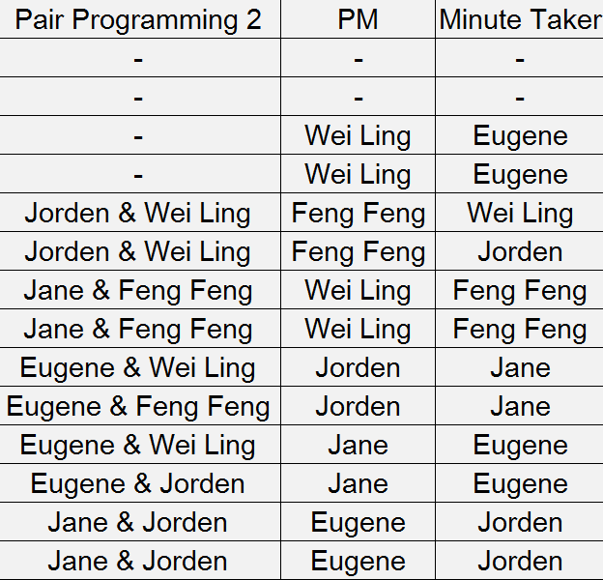
Updated PP/PM SCHEDULE

Slide 8
ITERATIONS
6 ITERATIONS
ITERATIVE TIME-BOXING
14 Days (2 Weeks): EXCEPT ITERATION 3 WHICH TOOK 3 WEEKS
ITERATION 4 WILL BE 1 WEEK

Slide 9
ITERATION 3
BLR & BOOTSTRAP
PAIR PROGRAMMING
BASIC LOCATION REPORTS (JANE & FENGFENG)
BOOTSTRAP (JORDEN & EUGENE/WEILING & EUGENE)
DISCUSSION ON SCHEDULE & KNOWLEDGE SHARING
COMPLETE BOOTSTRAP
BASIC LOCATION REPORTS COMPLETED TWO PARTS
WEEK 7 (05/10/2017) - WEEK 9 (19/10/2017)

Slide 10
ITERATION 4
HEATMAP, AGI AND CONTINUE ON BASIC LOCATION REPORT
COMPLETED HEATMAP
COMPLETE AGI
COMPLETE BASIC LOCATION REPORT
DISCUSSION ON SCHEDULE & KNOWLEDGE SHARING
WEEK 9 (22/10/2017) - WEEK 10 (29/11/2017)

Slide 11
ITERATION 5
DUAL INTERFACE & WRAPPING UP
DUAL UI (COMPLETE ALL CSS, JS & JSON)
FINAL PROJECT INTEGRATION
RIGOROUS TESTING FOR BUGS
COMPLETION BY 5 NOVEMBER
WEEK 11 (30/10/2017) - WEEK 12 (12/11/2017)

Slide 12
ITERATION 6
REFINEMENT
REVIEWING ON UAT COMMENTS
IMPROVING OUR SYSTEM BASED ON IT
WEEK 13 (13/11/2017 – 19/11/2017)

Slide 13
MILESTONES
APPLICATION DEMO AND PROGRESS UPDATE (WEEK 10)
UAT (WEEK 12)
FINAL PRESENTATION (WEEK 14)

Slide 14
TASK METRICS
Iteration No. | Planned Tasks | Completed Tasks | TM
1 | 5 | 7 | 1.4
2 | 8 | 10 | 1.25
3 | 24 | 29 | 1.208333333
4 | 18 | 2 | 0.1111111111
For Iteration 3, total number of tasks = 31 →Task metric score is thus a maximum of 129%
Since Task metric is between 110% and 150%:
Re-estimate the tasks for the future iterations.
Add the number of days gained to buffer days.

Slide 15
BUG METRICS
S/N | Iteration | Date found | Programming task | Bug(s) | Level of impact | Points | Resolved? | Cumulative Points for Iteration | Current unmitigated score
1 | 2 | 28/9/2017 | Validation of demographics.csv | Validation for email testing failed | Low impact | 1 | Yes | 1 | 0
2 | 3 | 4/10/2017 | Login | Exception thrown during login with invalid username | High impact | 5 | Yes | 5 | 0
3 | 3 | 11/10/2017 | Bootstrap | Couldn’t load data into database when using “load data infile” | High impact | 5 | Yes | 5 | 0
5 | 3 | 21/10/2017 | Additional File | Never record error message when verifying duplicates in file | Low impact | 1 | No | 6 | 0
6 | 3 | 21/10/2017 | Logout | Logout button fails to invalidate session | Low impact | 1 | Yes | 7 | 1
Course of action:
Immediate debugging during PP
If unresolved, schedule unplanned PP to solve bug

Slide 16
BUFFER TIME
ITERATION 3 → USED ALL BUFFER TIME FOR UNPLANNED PPs
SHOWCASED INACCURATE PLANNING FOR ITERATION 3
REVISED SCHEDULES/ CRITICAL PATHS FOR FUTURE ITERATIONS

Slide 17
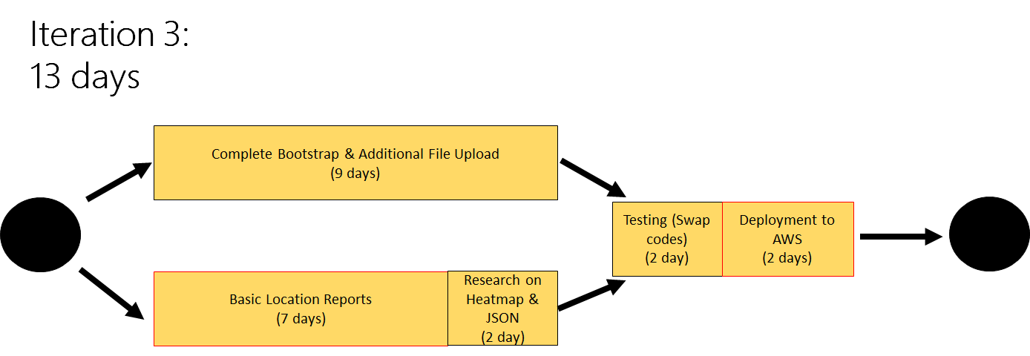
CRITICAL PATH
CRITICAL PATH

Slide 18
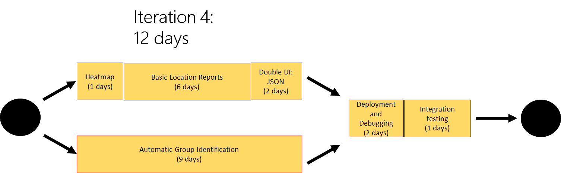
CRITICAL PATH

Slide 19
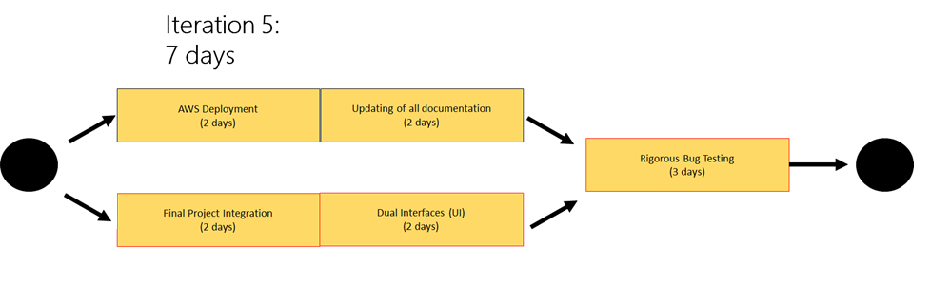
CRITICAL PATH

Slide 20
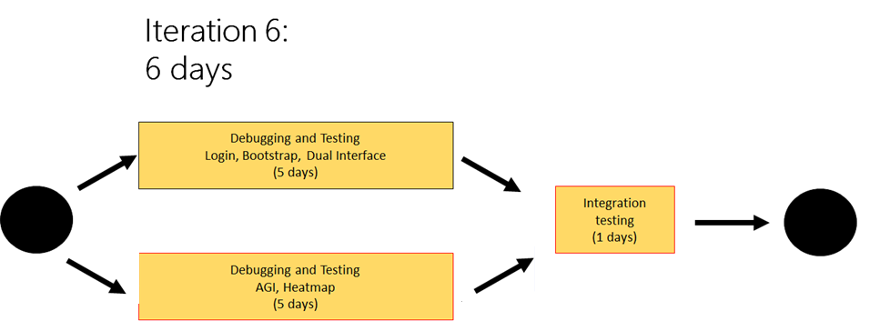
CRITICAL PATH
CRITICAL PATH

Slide 21
FOURTRESS OUT

